Slide 1
Cryptography
An Overview

Slide 2
WHY THE NEED FOR CRYPTOGRAPHY?
Confidentiality
Integrity
Key Exchange
Authentication
Non-Repudiation

Slide 3
Fundamental Problems?

Slide 4

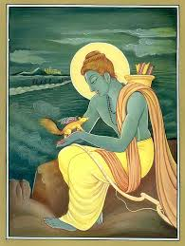

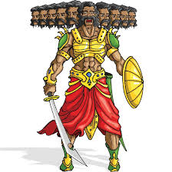

Fundamental Problems Addressed by Cryptography
Problem 1
Talking to Ram
Talking to Sita
Key Establishment
k
k
??
No intention of hurting any religious sentiments

Slide 5
Fundamental Problems Addressed by Cryptography
Core Problem 2
Secure Communication
m₁
m₂
m₃
k
k
??
Confidentiality
Integrity

Slide 6
Goal of Cryptography
Open channel
Private and authentic channel
Privacy
??
Authenticity
Integrity
Goal of cryptography

Slide 7
Types of Cryptographic Primitives
Symmetric-key primitives (private-key cryptography)
Same k used at both the ends
Computationally efficient
k
k
Key agreement a big issue
Asymmetric-key primitives (public-key cryptography)
Different k used at both the ends
Computationally inefficient
pk
sk
No key agreement required
In practice, we use a combination of both

Slide 8

Private-key/Symmetric-key Encryption
m
m
c
m
Encryption
Decryption
k
??
k
Key k shared in advance (by “some” mechanism)
m is the plain-text
c is the cipher-text (scrambled message)
Symmetry: same key used for encryption and decryption

Slide 9
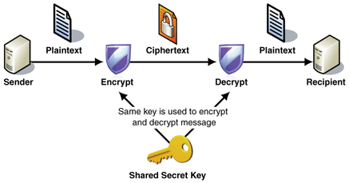
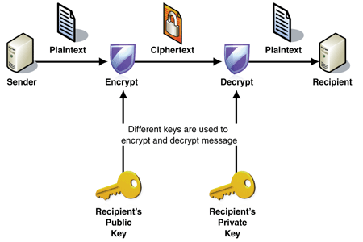
TYPES OF CRYPTOGRAPHY
Symmetric Cryptography
Asymmetric Cryptography
Source: [19/10/2018] https://sachi73blog.wordpress.com/2013/11/21/symmetric-encryption-vs-asymmetric-encryption/

Slide 10
Message Integrity and Authentication
Does secure-communication includes ONLY the privacy of the message?
What is the guarantee that a message received by R indeed originated from S and vice-versa ? --- issue of message authentication (MA)
Even if it is confirmed that the message received by R originated from S, what is the guarantee that the message content is genuine ? --- issue of message integrity (MI)
Message integrity and authentication are also part of secure communication
Message authentication/integrity is important even when privacy is not a concern
Any kind of access control system needs them. Think of bank, institute, any organization
Encryption scheme does not help (unless designed with specific purpose of MI and MA).
An attacker can forward any cipher-text to R on behalf of the S

Slide 11
TRADITIONAL CIPHERS
Traditional ciphers were character/symbol oriented as compared to the bit oriented modern day ciphers.
Its primary function was to scramble the plaintext in such a way that any interceptor of this ciphertext cannot make any sense out of it.
Traditional Ciphers
Substitution Ciphers
Transposition Ciphers
Monoalphabetic
Polyalphabetic

Slide 12
SUBSTITUTION CIPHER
Substitution cipher replaces one symbol/character with another one.
Monoalphabetic
Polyalphabetic
Every occurrence of a particular symbol/character is replaced with a same symbol/character.
Every occurrence of a particular symbol/character is replaced with different symbol/character.
Relationship: One to One
Relationship: One to Many
Plaintext: WELCOME
Ciphertext: ACHMIJC
Plaintext: WELCOME
Ciphertext: ACHMIJZ

Slide 13
SHIFT CIPHER
In this cipher, the encryption algorithm is “shift key characters down” and the decryption algorithm is “shift key characters up”, with key equal to some number.
Julius Cipher used the shift cipher to communicate with his officers on the battleground.
Caesar used key of key length 3 for his communications.
The shift cipher is sometimes referred to as the Caesar cipher.

Slide 14
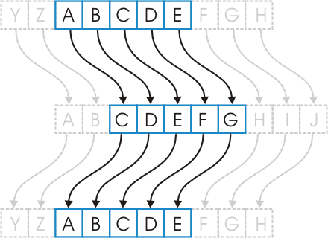
SHIFT CIPHER
Example:
Plaintext: WELCOME
Key: 5
Solution:
Ciphertext: BJQHTRJ

Slide 15
VIGENERE CIPHER
The Vigenere cipher is a method of encrypting alphabetic text by using a series of different Caesar ciphers based on the letters of a keyword.
Aimed at reducing the effectiveness of performing frequency analysis on the ciphertext, the Vigenere cipher uses a text string as a key, which is then used for doing a number of alphabet shifts on the plaintext.
It is a simple form of polyalphabetic substitution in which each alphabet can replace with several cipher alphabets.
Instead of performing a single alphabetic shift like in Caesar cipher, Vigenere cipher uses a key to determine the number of alphabetic shifts across the entire plaintext.

Slide 16
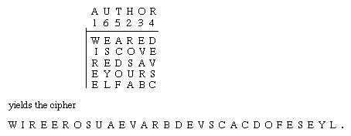
TRANSPOSITION CIPHER
Transposition cipher reorders symbols/characters in a block of symbols/characters.
Unlike substitution cipher, in transposition cipher there is no substitution of symbols.

Slide 17
DATA ENCRYPTION STANDARD (DES)
Symmetric key block-cipher with a block size of 64 bits.
Designed by IBM (with the help from NSA) in 1970.
Adopted by the US government as the Federal Information Processing Standard in 1977.
DES in original form with key length: 56 bits is considered no longer secure, because of its vulnerability to brute-force key search.
DES was criticized because of its short key length. To overcome the issue, Triple DES was developed with a key length that tripled the size of DES’s key length.

Slide 18
ADVANCED ENCRYPTION STANDARD (AES)
1997: US National Institute of Standards and Technology (NIST) announced a competition to come up with a better block-cipher as a replacement of DES
2000: After rigorous analysis of the submissions (some of the best cryptographers in the planet were part of the whole process) the finalist selected were:
Rijndael: designed by Belgian cryptographers Vincent Rijmen and Joan Daemen. The scheme now popularly known as the AES.

Slide 19
ADVANCED ENCRYPTION STANDARD (AES)
Key length determines the key-schedule and the number of rounds
Unlike DES (which uses a Fiestel network), AES is based only on Substitution Permutation Networks (SPN).
AES Overview
Block length – 128 bits
Key length – Support for 128, 192 or 256 bits

Slide 20
What is OTP?

Slide 21
ONE TIME PAD (OTP)
OTP also known as the Vernan cipher is a cryptographic algorithm that produces ciphertext by combining the plaintext with a random key.
Considered as one of the toughest and most secure cryptographic algorithm because of randomness of the key used in it.
OTP rules are as follows:
The key should consist of truly random numbers
Only two copies of the keys should exist
Each key should be used only once
Both the sender and receiver should destroy their key after use

Slide 22
RSA
RSA is the most common public-key encryption algorithm, and is named for its inventors Rivest, Shamir, and Adleman (RSA). It has survived all attempts to break it for more than 30 years and is considered very strong.
Although RSA can be used to encrypt and decrypt actual messages, it is very slow if the message is long.
RSA, therefore, is useful for short messages such as a small message digest or a symmetric key to be used for a symmetric-key cryptosystem.
RSA is also used for authentication.

Slide 23
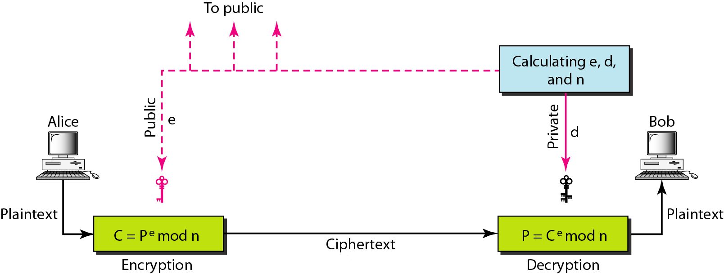
RSA

Slide 24
MESSAGE INTEGRITY AND AUTHENTICATION
Does secure-communication includes only the privacy of the message?
What is the guarantee that a message received by R, indeed originated from S and vice-versa ? --- issue of Message Authentication (MA)
Even if it is confirmed that the message received by R originated from S, what is the guarantee that the message content is genuine ? --- issue of message integrity (MI)
Encryption scheme does not help (unless designed with specific purpose of MI and MA).

Slide 25
HASH FUNCTION
One common way of protecting the integrity of the message is, the sender putting his/her fingerprint on the message document.
Using this technique, even if the message document gets intercepted by a person “H”; “H” cannot forge the sender’s fingerprint for creating a false document.
The electronic equivalent of document and fingerprint pair is the message and message digest pair.
To prevent the integrity of a message, the message is passed through an algorithm called as hash function.

Slide 26
HASH FUNCTION
Flowchart: User Authentication Process

Slide 27
DIGITAL SIGNATURE
When a sender “S” sends a message to the receiver “R”, “R” needs to check the authenticity of “S”. “R” needs to be sure that the message came from “S” and not third person “H”.
For this, “R” can ask “S” to sign the message electronically.
The signature is a proof to the recipient that the document has arrived from the correct sender.
A signature on a document, when verified, is a sign of authentication.
“S” sends two documents: the message and the signature. “R” receives both the documents and verifies that the signature belongs to “S”. If verified, the message is kept by “R” or else it is discarded.

Slide 28
DIGITAL SIGNATURE
Signing Process

Slide 29
DIGITAL SIGNATURE
Verification Process

Slide 30
DIGITAL CERTIFICATE
A certificate is nothing more than a mechanism that associates the public key with an individual.
Digital certificates serve a single purpose: proving the identity of a user or the source of an object.
They don’t provide proof as to the reliability or quality of the object or service to which they’re attached; they only provide proof of where that product or service originated.
Certificates work under a theory known as the trusted third party. This theory states that if user A trusts user C and user B trusts user C, then user A can trust B and vice versa.

Slide 31
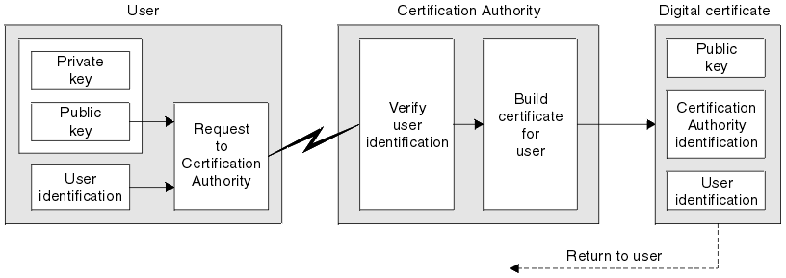
DIGITAL CERTIFICATE

Slide 32
PUBLIC KEY INFRASTRUCTURE
A Public Key Infrastructure (PKI) is a system of facilities, policies, and services that supports the use of public key cryptography for authenticating the parties involved in a transaction.
A public key infrastructure (PKI) supports the distribution and identification of public encryption keys, enabling users and computers to both securely exchange data over networks such as the Internet and verify the identity of the other party.
The X.509 standards provide the basis for the industry standard Public Key Infrastructure.

Slide 33
PUBLIC KEY INFRASTRUCTURE
There is no single standard that defines the components of a Public Key Infrastructure, but a PKI typically comprises of the following components:
Certification Authority (CA)
Registration Authority (RA)
Acts as the root of trust in a public key infrastructure and provides services that authenticate the identity of individuals, computers, and other entities in a network.
Is certified by a root CA to issue certificates for specific uses permitted by the root.
Certificate Database
Saves certificate requests and issued and revoked certificates and certificate requests on the CA or RA.
Certificate Store
Saves issued certificates and pending or rejected certificate requests on the local computer.

Slide 34
STEGANOGRAPHY
Steganography derived from Greek origin word “steganos” (covered) and “graphein” (writing), is an art of hiding a secret message within an ordinary message.
Example
Since everyone can read, encoding text in neutral sentences is doubtfully effective.
“Secret Inside”

Slide 35
Thank You & Queries

